Slide 1
MOVIE DATA ANALYSIS
As Silver Screen unfolds, u unfold a mini-you in your Imagination.
By: Shiva Charan. P
Under the Guidance of: Dr. Aakansha Gupta

Slide 2
Introduction
A production company wants to analyze TMDB movie data and gain insights into various aspects of the movies and identify what kinds of movies perform well in cinemas, which genres they belong to, and a few other parameters, which help the company predict if a movie will be a commercial success and highly rated.
Objective:
1. Explore the relationship between movie attributes and their popularity.
2. Identify trends and patterns in movie genres, budgets, and revenues.
3. Investigate the impact of cast, crew, and production companies on movie success.
4. Predict movie ratings based on key features.
Tools Used:
Tools used for this Analysis are Jupyter Notebook, Tableau, & Figma

Slide 3
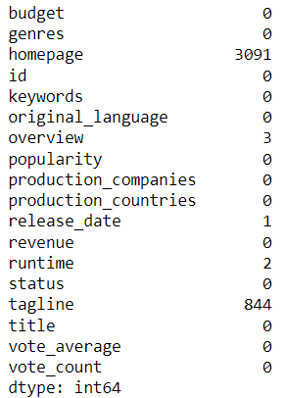
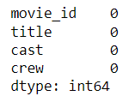
Overview:
Movies dataset
There are 2 different data sets containing credits and movies having 4803 rows each with 4 columns in credit and 18 columns in the movie data set.
Some of the columns like crew, cast, etc are in JSON format.
There are 3091 null values in the Homepage column and 844 null values in the tagline column. And there are a few other null values that can be handled.
Null Values are treated accordingly.
credits dataset

Slide 4
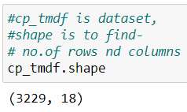
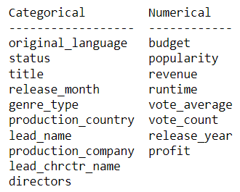

Data Cleaning :
The features which are highlighted have been extracted from the JSON characteristic features.
For ‘Budget’, ‘Revenue’ & ‘Runtime’ dropped the records where the values are zero.
The Outlier treatment is performed on the ‘Runtime’.
A few Features are having null values, and as they are less than 2% treated accordingly.
The clean dataset shape is 3229 x 18 (Rows x Columns).
Divided the dataset into categorical and numerical for further analysis.

Slide 5
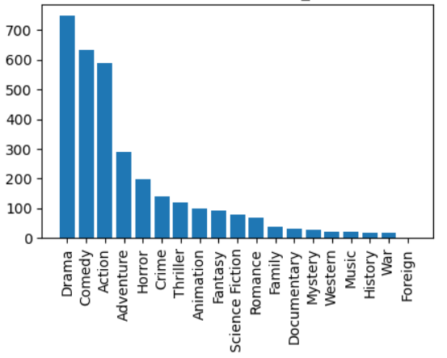
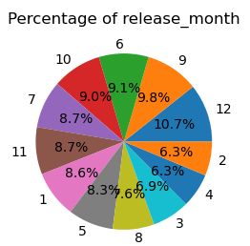
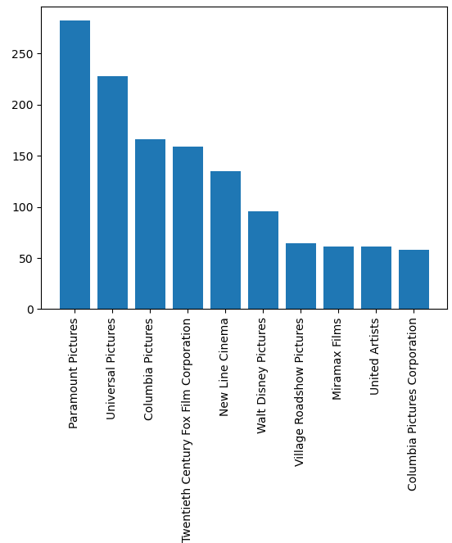
Data Exploration :
Conclusion:
Most films were released in the month of “December.”
‘Paramount Pictures’ tops the list of production companies.
Most films were in the ‘Drama Genre’.

Slide 6
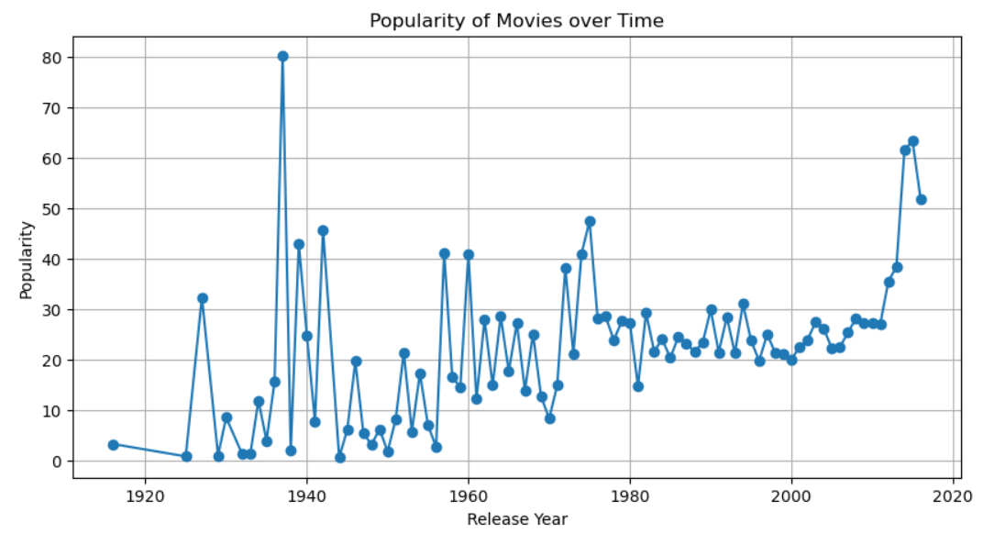
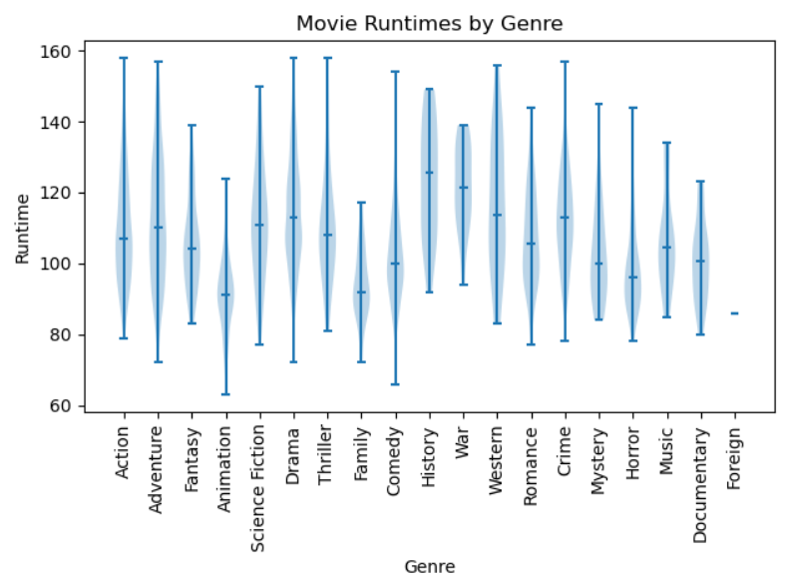
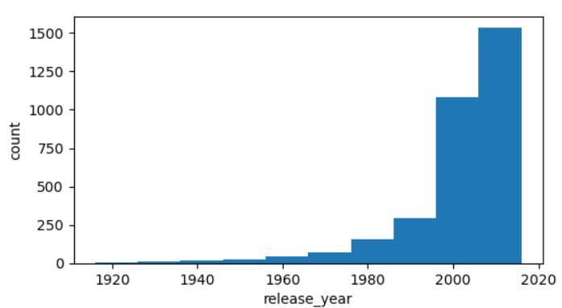
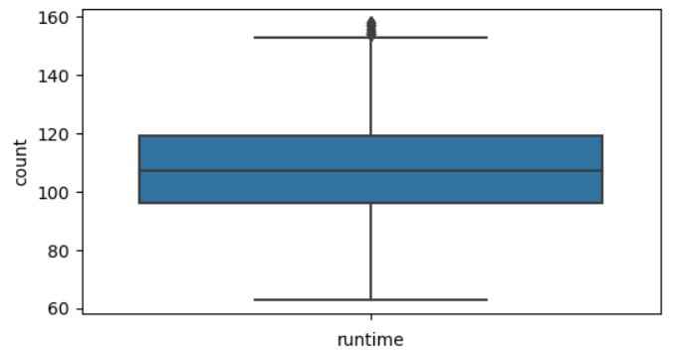
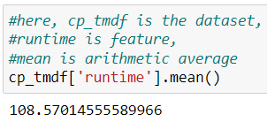
Data Exploration :
Conclusion:
The Average ‘Runtime’ is 108 mins.
‘Western movies runtime is 80 – 160 mins’, and most films were released in the last 20 years.

Slide 7
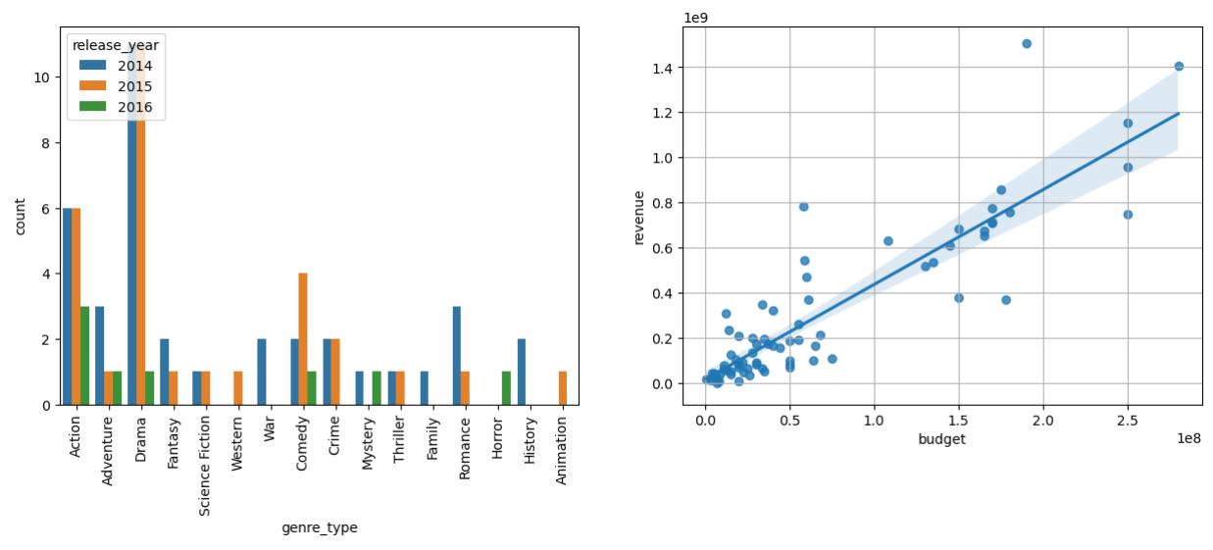
Data Exploration :
Condition: Films as language ‘English’ with a vote average, release year equal to and greater than 7 & 2014 respectively.
Conclusion:
Most of the movies were related to ‘Drama’ and maximum films released in 2014, and 2015.
The budget plays an important role in high-revenue films.
Linear Relationship between Budget and Revenue.

Slide 8
Summary:
Most films were released in the month of ‘December’.
‘Paramount Pictures’ produced a lot of movies when compared to other production companies.
Genres like ‘Fantasy’ and ‘Animation’ runtime is in the range between 80 – 120 mins.
Before 1970 there are less than 250 films as per the Data.
Budgets play an important role in high-revenue films.
There was a spike in popularity between 1935 – 1940.

Slide 9
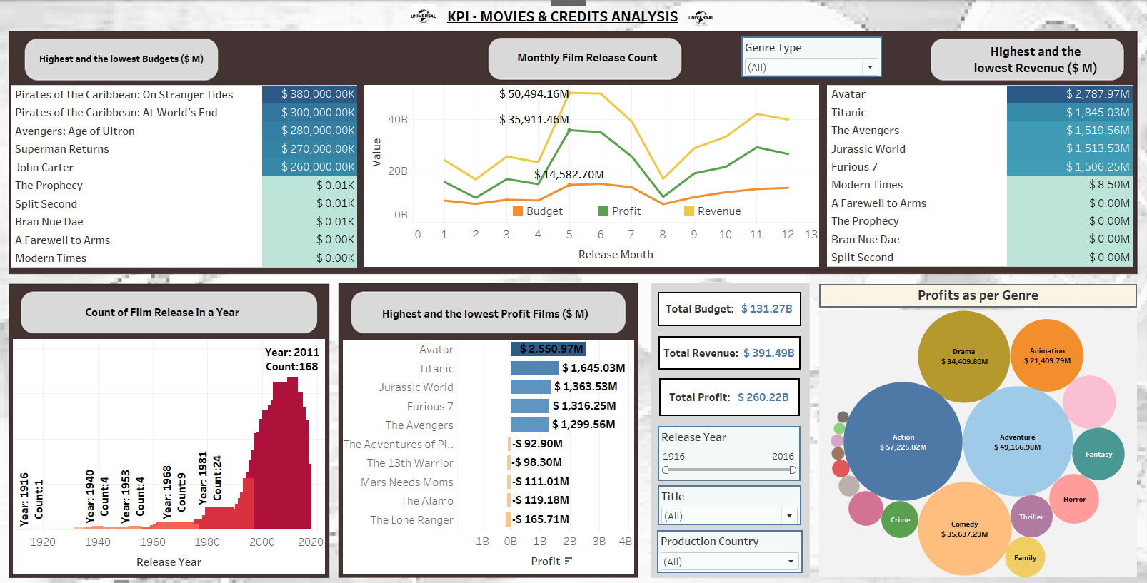
Tableau :

Slide 10
Summary:
The Highest Budget was spent on the Pirates of the Caribbean series – Stranger Tides and World’s End, and the lowest was on Modern Times.
168 films were released in the year 2011.
The Revenue was high in the month of May when compared to other months in the year.
Most Profits were seen in ‘Action’ followed by the ‘Adventure’ Genre, the highest profit was for ‘Avatar’, followed by ‘Titanic’ and ‘Jurassic Park’.
‘Avatar’ & ‘Titanic’ generated high Revenue.
Most profit over the years is gained in the ‘Action’ Genre.

Slide 11
Classification Models:
Logistic Regression:
Logistic Regression is a popular, interpretable, and computationally efficient classification algorithm that serves as a baseline model.
Naive Bayes:
Naive Bayes - Gaussian is a simple yet powerful probabilistic classifier that assumes Gaussian distribution and performs well with independence assumptions.
Decision Tree Classifier:
A Decision Tree Classifier is a versatile and intuitive model that partitions the feature space based on decision rules, but it may be prone to overfitting.
Random Forest Classifier:
Random Forest Classifier is an ensemble method that combines multiple decision trees, reducing overfitting and improving generalization through voting or averaging.
Ada-Boost Classifier:
AdaBoost Classifier is an adaptive boosting ensemble method that iteratively trains classifiers, focusing on difficult samples and improving performance.
K-Nearest Neighbor Classifier:
KNN Classifier is a non-parametric algorithm that assigns classes based on the majority vote of its neighbors, suitable for nonlinear decision boundaries and local patterns.
Stacking Classifier:
Stacking Classifier combines multiple models with a meta-classifier on top, learning to combine their predictions for improved performance.

Slide 12
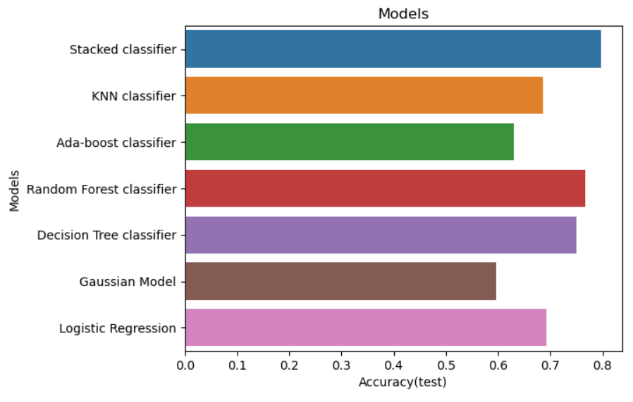
Classification based on the Rating :
Models | Accuracy(Train) | Accuracy (Test) | Precision | Recall | F1 Score
Logistic Regression | 0.673060 | 0.693049 | 0.691132 | 0.697194 | 0.685999
Gaussian Model | 0.583063 | 0.596696 | 0.632264 | 0.604636 | 0.555055
Decision Tree classifier | 0.737386 | 0.750860 | 0.743051 | 0.753251 | 0.745884
Random Forest classifier | 0.763942 | 0.766690 | 0.759656 | 0.769034 | 0.761633
Ada-boost classifier | 0.642372 | 0.630420 | 0.457980 | 0.642310 | 0.525493
KNN classifier | 0.717616 | 0.686167 | 0.672876 | 0.688798 | 0.676123
Stacked classifier | 0.809383 | 0.797660 | 0.794666 | 0.800317 | 0.796748
Conclusion: The Stacked Model Outperformed all the Models when it comes to the rating category. (Test score accuracy is 0.79)

Slide 13
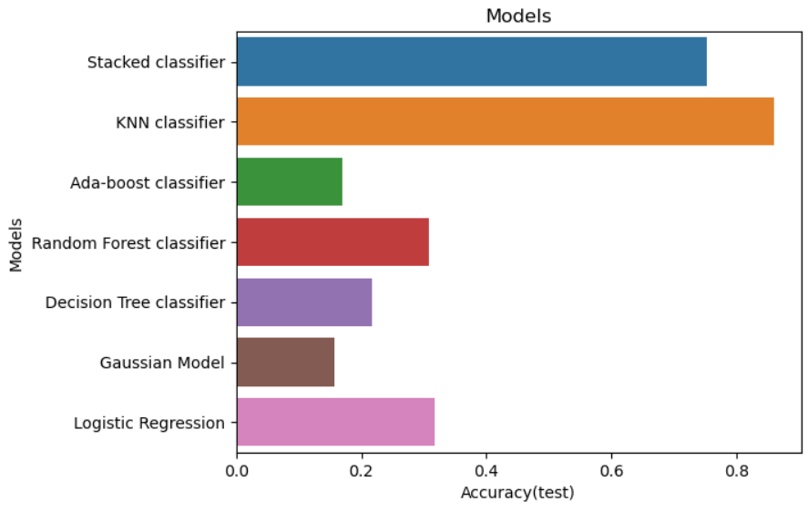
Classification based on the Genre:
Models | Accuracy(train) | Accuracy(test) | Precision | Recall | F1 score
Logistic Regression | 0.338398 | 0.316559 | 0.316559 | 0.316559 | 0.316559
Gaussian Model | 0.147684 | 0.156420 | 0.156420 | 0.156420 | 0.156420
Decision Tree classifier | 0.216532 | 0.217898 | 0.217898 | 0.217898 | 0.217898
Random Forest classifier | 0.299299 | 0.307387 | 0.307387 | 0.307387 | 0.307387
Ada-boost classifier | 0.168402 | 0.169807 | 0.169807 | 0.169807 | 0.169807
KNN classifier | 0.964832 | 0.860188 | 0.860188 | 0.860188 | 0.860188
Stacked classifier | 0.797918 | 0.752603 | 0.752603 | 0.752603 | 0.752603
Conclusion: The KNN (K-Nearest Neighbors) performed well on the training and the test data. (0.86)

Slide 14
Regression Models:
Linear Regression – Linear Model for predicting numeric values based on linear relationships between variables.
Decision Tree Regressor – Tree-based model that predicts numeric values by recursively partitioning the feature space.
Random Forest Regressor – Ensemble of decision trees that improves prediction accuracy through averaging.
Ada Boost Regressor – Boosting Algorithm that combines weak models to create a strong learner for numeric predictions.
Kneighbors Regressor – Non-Parametric model that predicts values based on the average of the k nearest neighbors in the training set.
Stacking Regressor – Ensemble technique that combines multiple regression models using a meta-model to make final predictions.

Slide 15
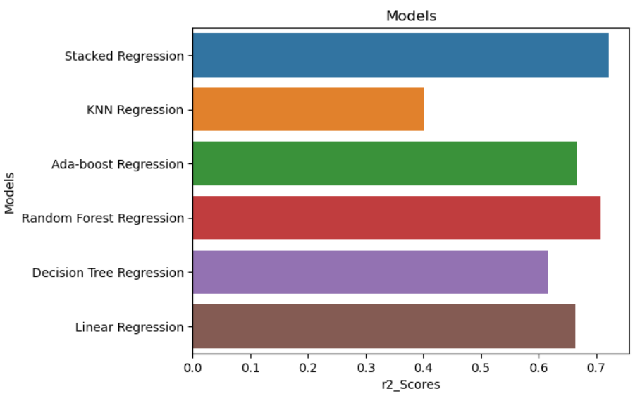
Performance of Regression Models:
Models | r2 Score(Train) | r2 Score(Test) | RMSE | MSE | MAE | MAPE
Linear Regression | 0.707929 | 0.664454 | 1.012589e+08 | 1.025336e+16 | 6.123943e+07 | 3109.273646
Decision Tree Regression | 0.732105 | 0.616562 | 1.094187e+08 | 6.165623e-01 | 5.946879e+07 | 4857.638085
Random Forest Regression | 0.797872 | 0.706579 | 9.571712e+07 | 7.065792e-01 | 5.546623e+07 | 3208.180803
Ada-boost Regression | 0.779408 | 0.666494 | 1.020460e+08 | 6.664940e-01 | 6.411359e+07 | 3718.112935
KNN Regression | 0.506284 | 0.400593 | 1.368060e+08 | 4.005926e-01 | 8.398391e+07 | 5073.601594
Stacked Regression | 0.783600 | 0.721511 | 9.324989e+07 | 7.215108e-01 | 5.456616e+07 | 2506.662457
Conclusion: The Random Forest performed well on the training data but overall Stacked Model performance was better. (Test score is 0.72)

Slide 16
Clustering Models:
Curse of Dimensionality (PCA):
The curse of dimensionality refers as the number of dimensions increases, the data becomes increasingly sparse, with most data points being far apart from each other in the high-dimensional space.
KMeans:
KMeans clustering is a partition-based clustering algorithm that aims to divide data into distinct groups by minimizing the variance within each cluster and maximizing the separation between clusters.
Hierarchical Clustering:
An algorithm that groups similar data points into nested clusters, forming a hierarchy or dendrogram based on their pairwise distances.
DBSCAN :
DBSCAN (Density-Based Spatial Clustering of Applications with Noise), clusters are selected based on the density connectivity. Noise points, which do not belong to any cluster.

Slide 17
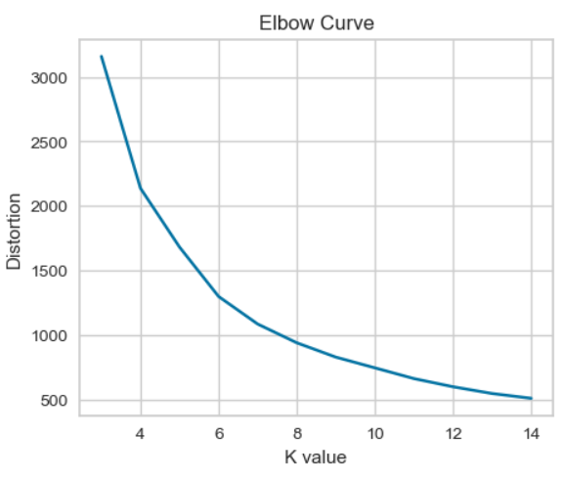
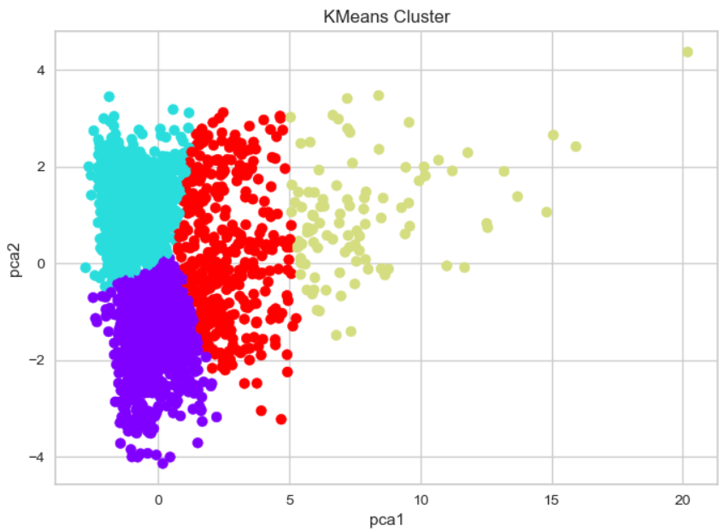
Performance of Clustering Models:
Scores Comparison:
The Silhouette Score for KMeans is high when compared to other models.
Models | Silhouette Scores
KMeans Clustering | 0.494696
Hierarchical Clustering | 0.479407
DBSCAN Clustering | 0.096667
Kmeans:
An Unsupervised Machine Learning algorithm that groups similar data points into clusters.
Elbow Method: Select the value of k at the "elbow“ point in the plot.
The plot shows the data points plotted based on their feature values, and the points are colored according to the assigned cluster.

Slide 18
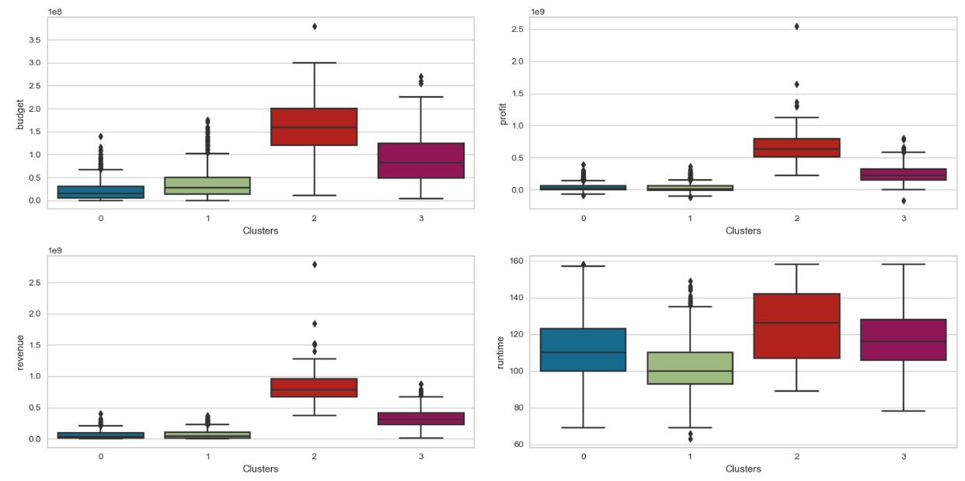
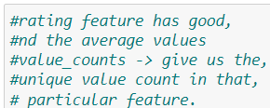
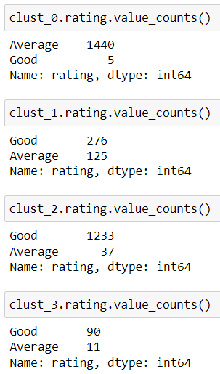
KMeans:
As per the KMeans 4 Clusters were formed and ‘Cluster 2’ performance tops in regards to budget, revenue, profit, and runtime features.

Slide 19
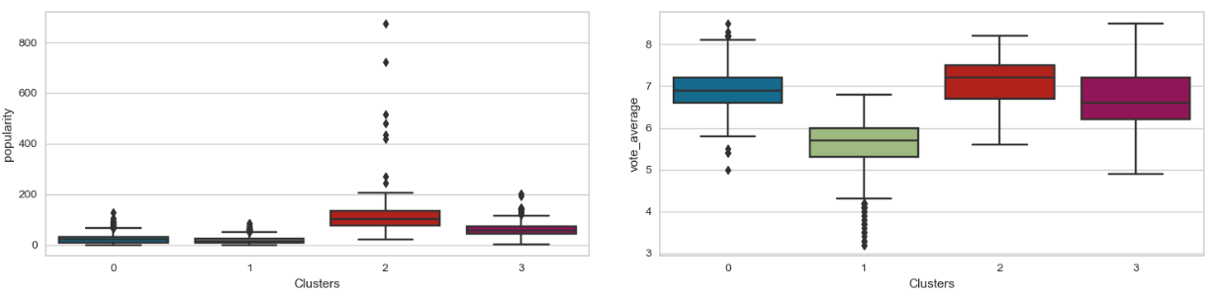
KMeans:
Cluster 2 Insights:
Totally 101 records fall under the cluster 2 category where the language of the films is English.
The average runtime of these movies is 124 mins, with an average vote of 7.09.
Most of the films in the cluster2 genre are “Action”.
‘Daniel Radcliffe’ is the most repeated actor in this cluster, and ‘Peter Jackson’ is the repeated director.
The maximum budget is $ 380 m.
Most movies are released in the month of June (count - 21), followed by May (count - 18).

Slide 20
Summary:
Classification Models:
Based on Genre and the Rating the Classification has been performed, in both different models are giving different scores.
The Stacked Model Outperformed all the Models when it comes to the rating category.
The KNN (K-Nearest Neighbors) performed well on the training and the test data, followed by the Stacked Model.
Regressor models:
The Random Forest performed well on the training data but overall Stacked Model performance was better. (Test score is 0.72)
Clustering Models:
The Silhouette Score for KMeans is high when compared to other models.
Based on the patterns drawn out from each cluster formed, ‘Cluster 2’ gives better insights.

Slide 21
Thank You

